Slide 1
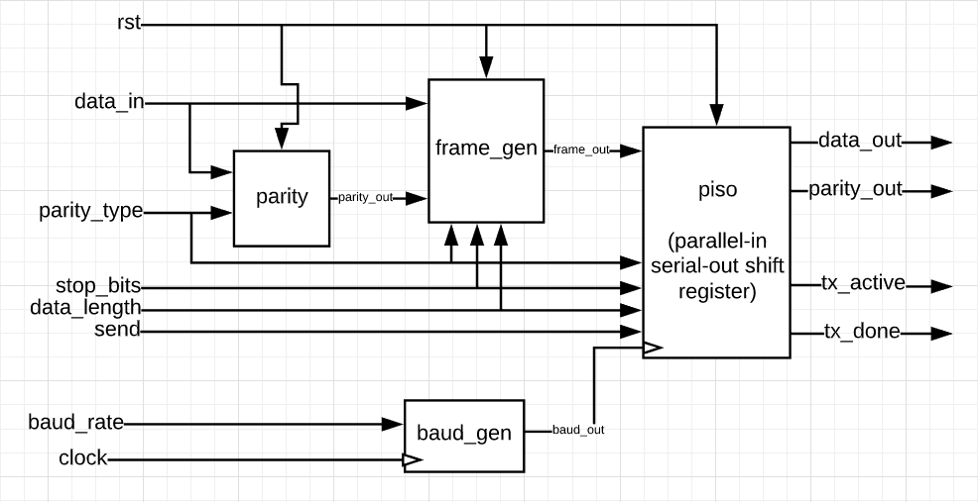
UART: Transmitter

Slide 2
Sub Modules
Top Module
(Main uart_tx)
Parity
Frame generator
Baud generator
PISO

Slide 3
The system of the UART consists of transmitter and receiver, but in this project we will make the transmitter only.. As old castles when they sent massages to each other, they have a protocol to sent this data and be sure that this data sent correctly. In this protocol: we use the frame generator as the message carrier and the parity module as the error checker to our message.

Slide 4
Parity module

Slide 5
Error checking: Parity Bit
A parity bit is a basic method to check whether the received data is correct or erroneous.
We use it in the project to check the sent bit whether it had been sent correctly or not.
This table explains the full module, but we actually made the transmitter only
Parity type (in transmitter) | Output (receiver) | description
00 (no parity) | x | No parity
01 (odd parity) | 1 when error (even) 0 when (odd) | With odd parity, the bit is only 0 when the number of ones is odd.
10 (even parity) | 1 when error (odd) 0 when (even) | With even parity, the bit is only 0 when the number of ones is even.
11 (special case) | 1 when error (even) 0 when (odd) | use the output parity_out as an odd parity bit and no parity in the serial frame(like 00).

Slide 6
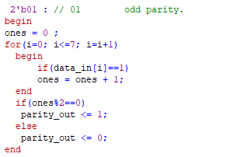
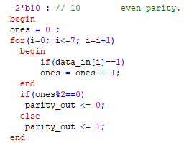
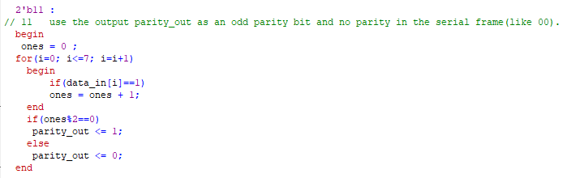
Some explanations in parity module
Case 01
Case 10
Case 11

Slide 7
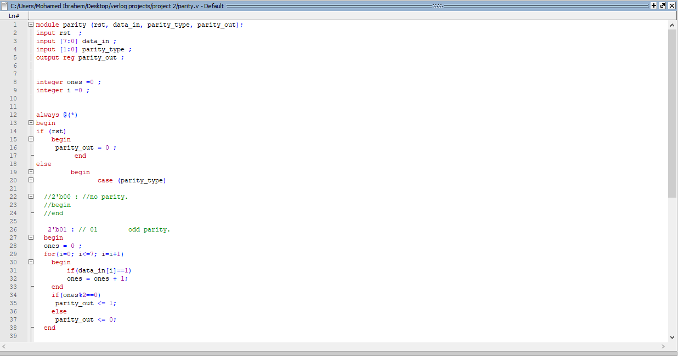
Parity module code

Slide 8
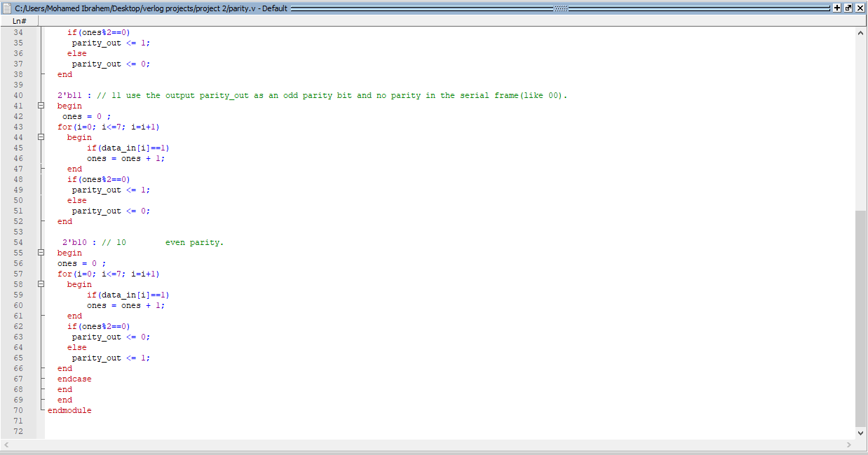

Slide 9
The baud generator module

Slide 10

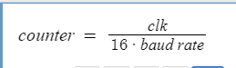
Baud Generator:

Slide 11
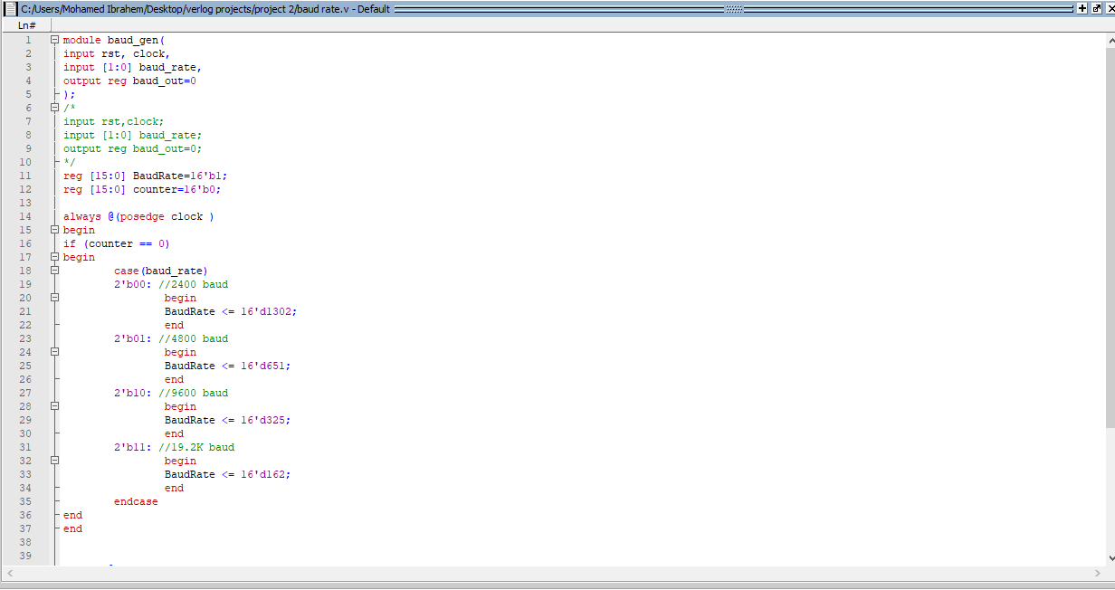

Slide 12
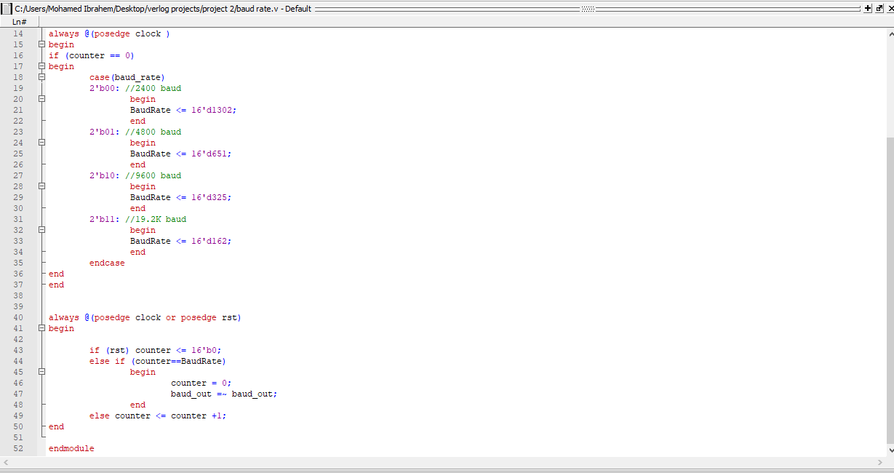

Slide 13
The frame generator module

Slide 14
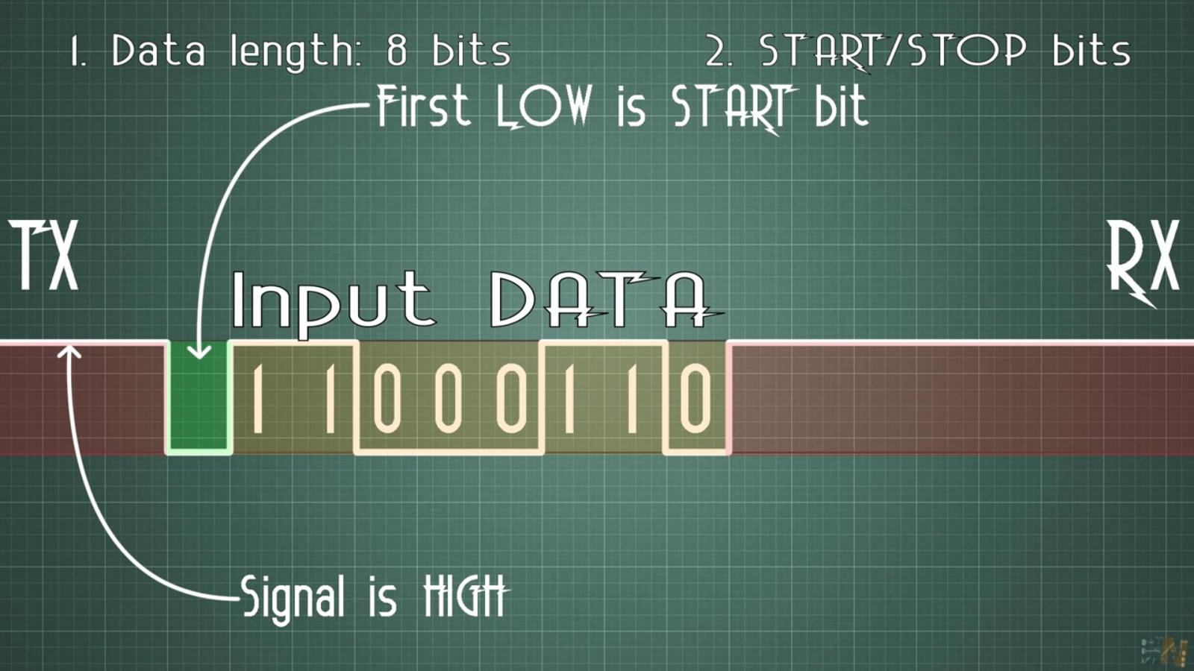
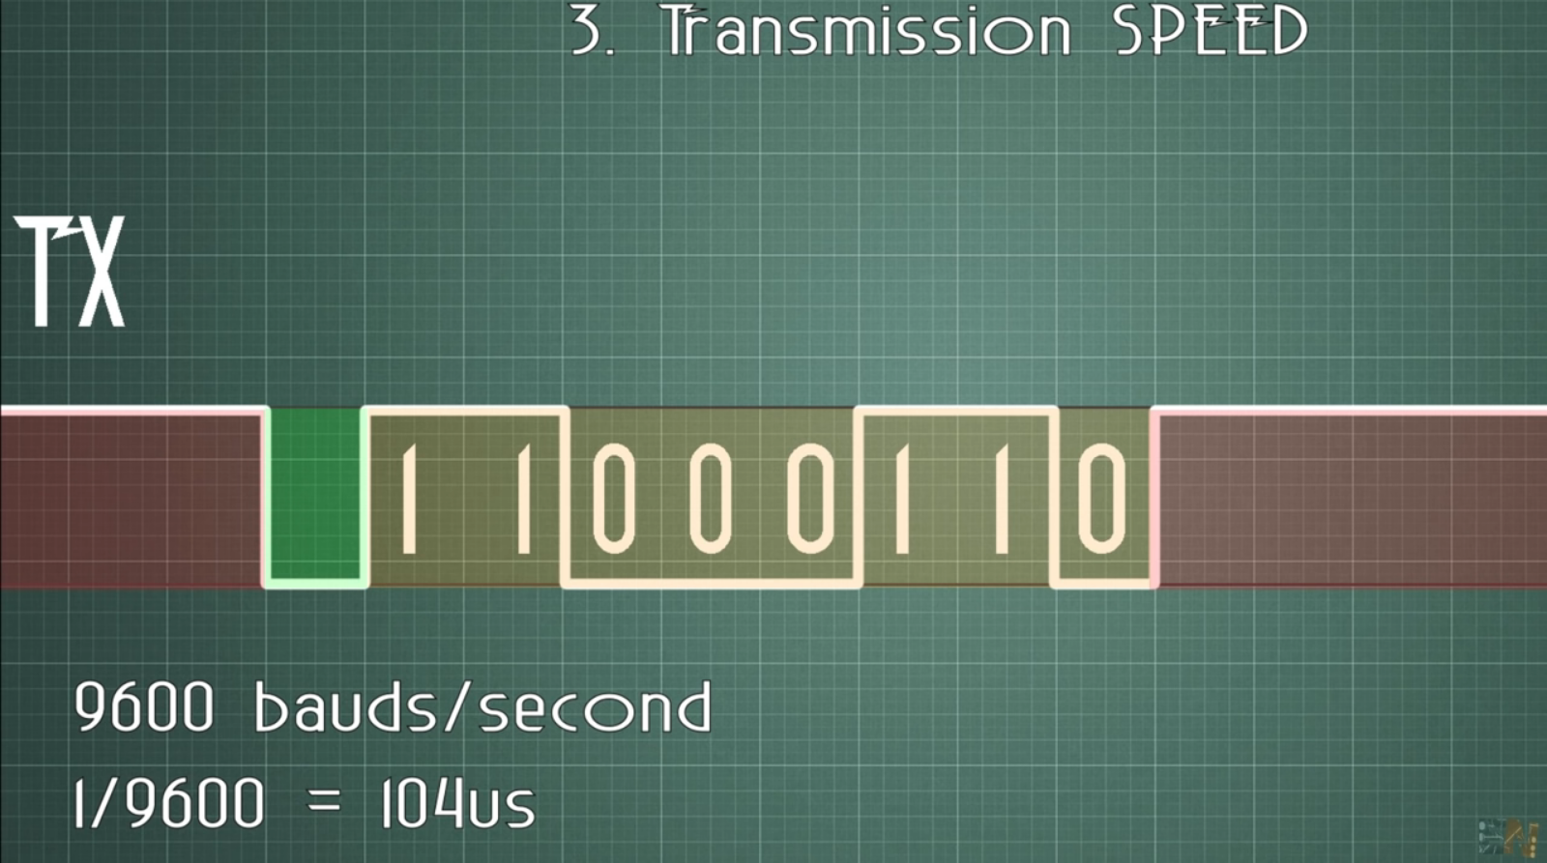
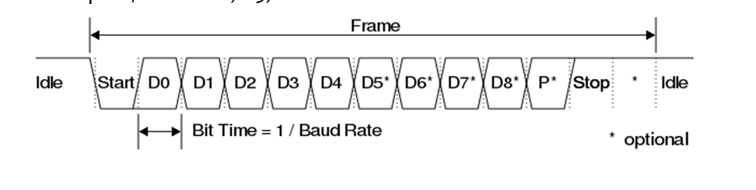

Slide 15
Frame Generation:
Parity Type
00
01
11
10
Data length -7 bit-
Data length -8 bit-
One stop bit -0-
Two stop bit -1-
Data length -7 bit-
One stop bit -0-
Two stop bit -1-
Data length -8 bit-
One stop bit -0-
Two stop bit -1-
One stop bit -0-
Two stop bit -1-
Start|7 bit data | Stop
Start|8 bit data | Stop
Start|8 bit data | Parity| Stop
Start|7 bit data|2 bit Stop
Start|8 bit data|2 bit Stop
Start|7 bit data|Parity|2 bit Stop

Slide 16
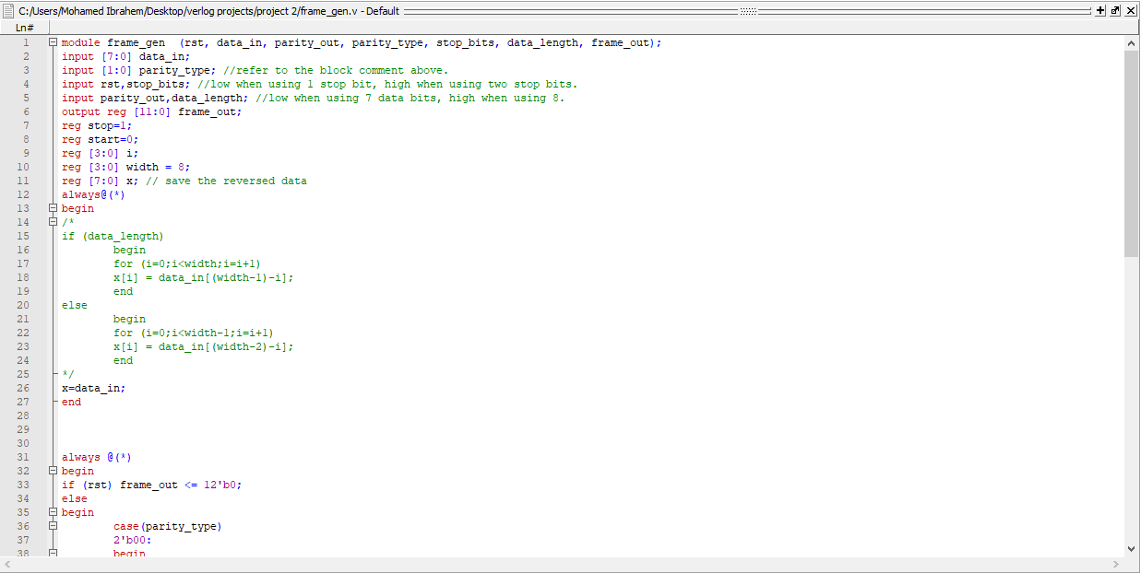

Slide 17
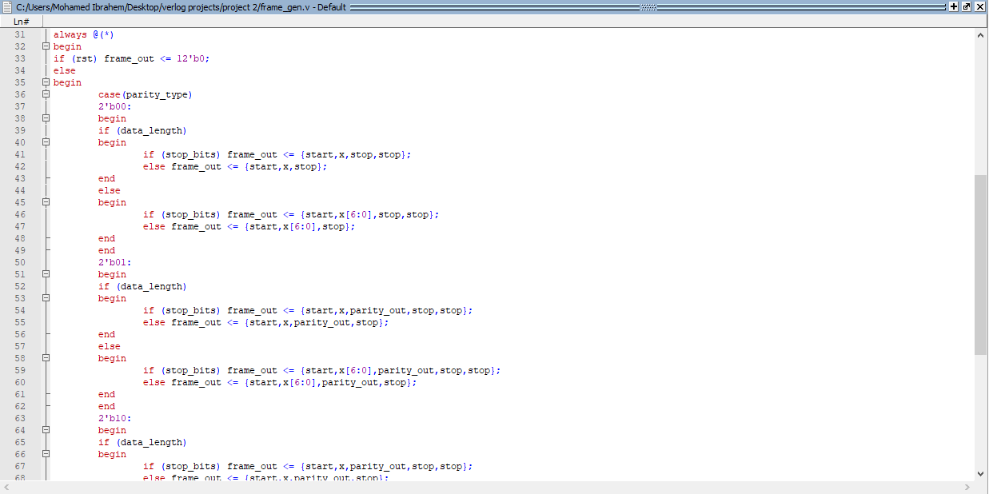

Slide 18
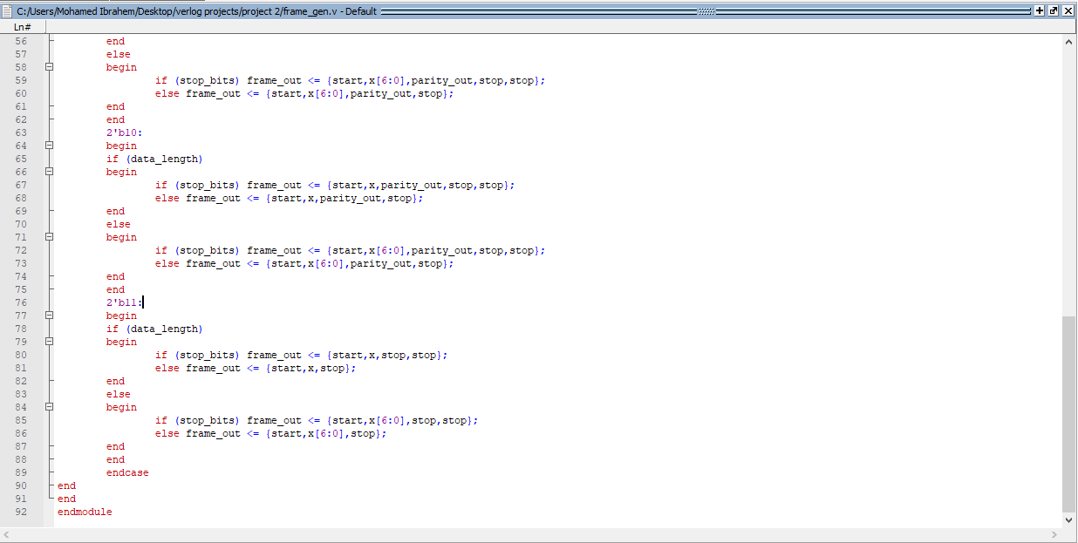

Slide 19
The PISO module parallel in serial out

Slide 21
P_parity_out
it is like a flag to the frame.
It will be 1 if the frame doesn’t have parity bits.
It will be 0 if the frame have parity.
parallel odd parity output, low when using the frame parity.

Slide 22
As we know the PISO takes the data in from the frame out. Then we select whether if the data type 1 for selecting 8 bits data input or 0 for 7 bits. The next page describes how the tx active and tx done works.

Slide 23
Tx_active | Tx_done | sttus
0 | 0 | Waiting to send signal
1 | 0 | Now starting to send packets and the procedure under process
0 | 1 | the transmitter is done from sending data
1 | 1 | The transmitter done sending data and next step it will be 0 0 to be waiting to send signal
Waiting for send signal
00
10
01
11
Sending data procedure is in process
After done sending, it prepares itself again to be waiting for send signal
Done sending data

Slide 24
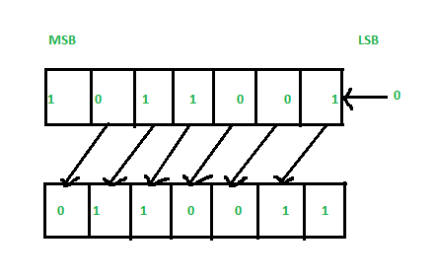
Explain data out shifting
The PISO looks like shift register, specially like left shift register .
And the serial data out always equals to the MSB of this parallel data in.

Slide 25
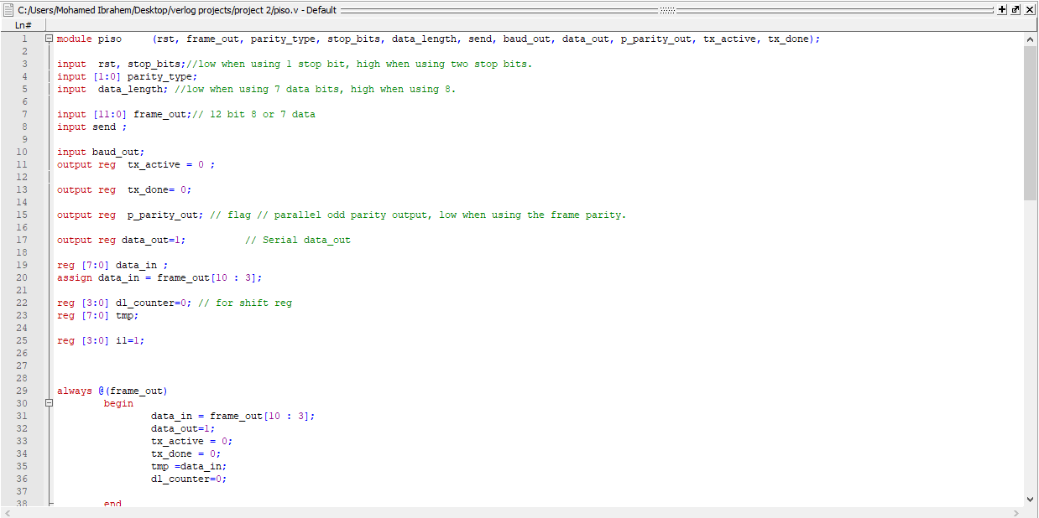
PISO (CODE):

Slide 26
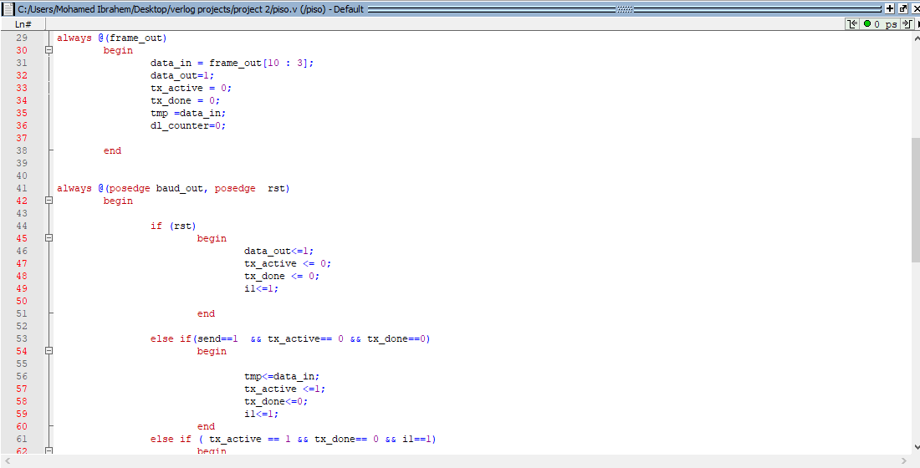

Slide 27
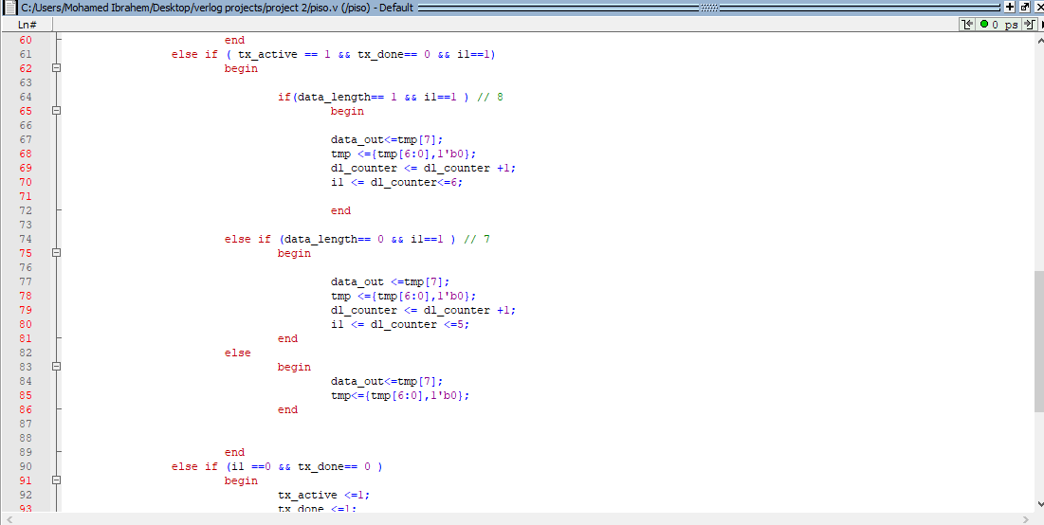

Slide 28
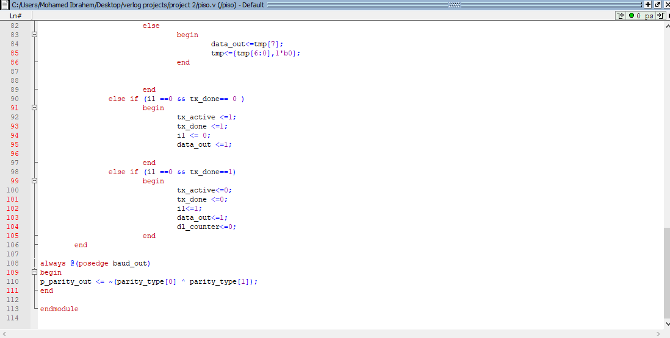

Slide 29
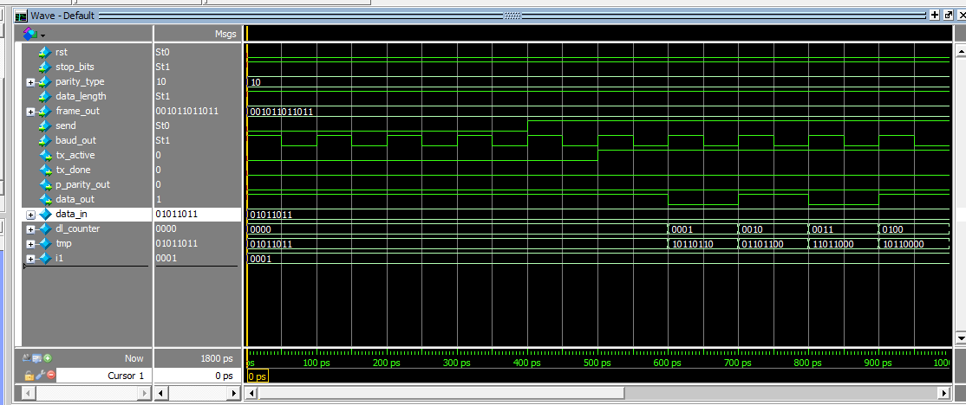
simulation

Slide 30
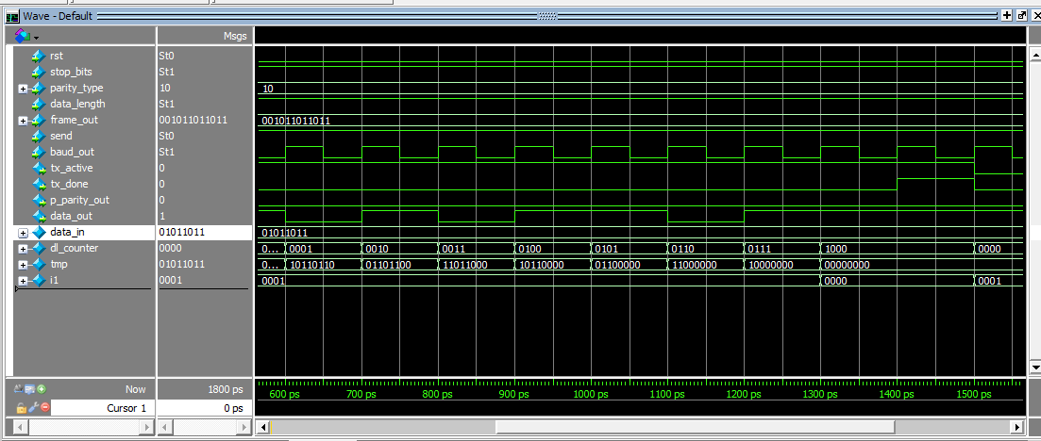

Slide 31
The next will be the Full UART module

Slide 32
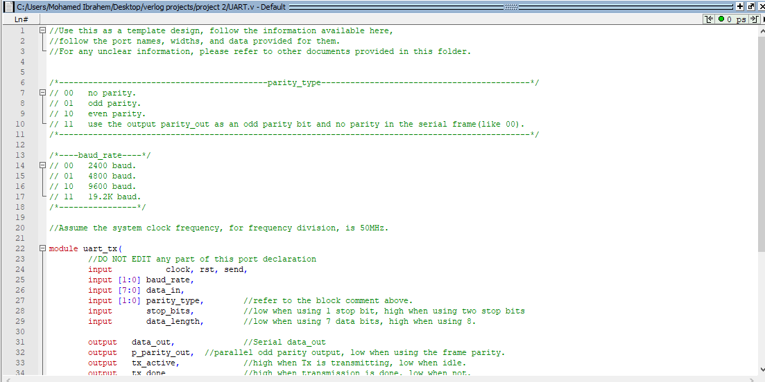
Full UART module (CODE)

Slide 33
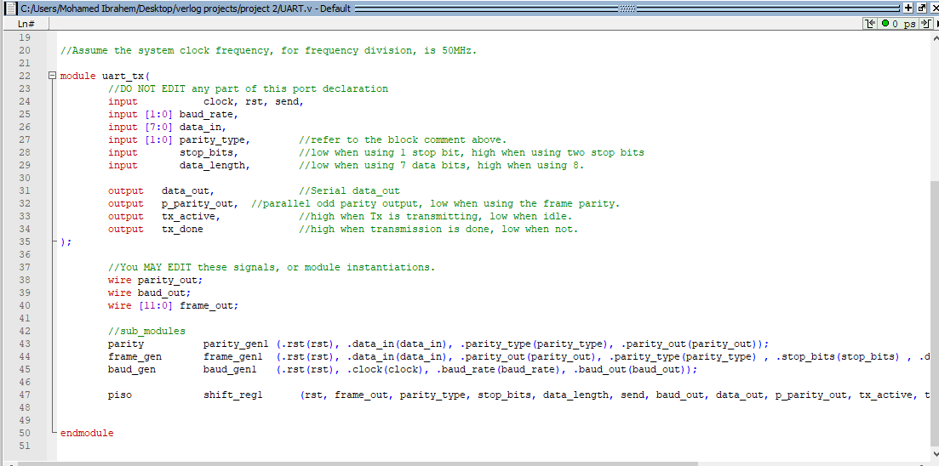

Slide 34
The next will be the UART full test bench

Slide 35
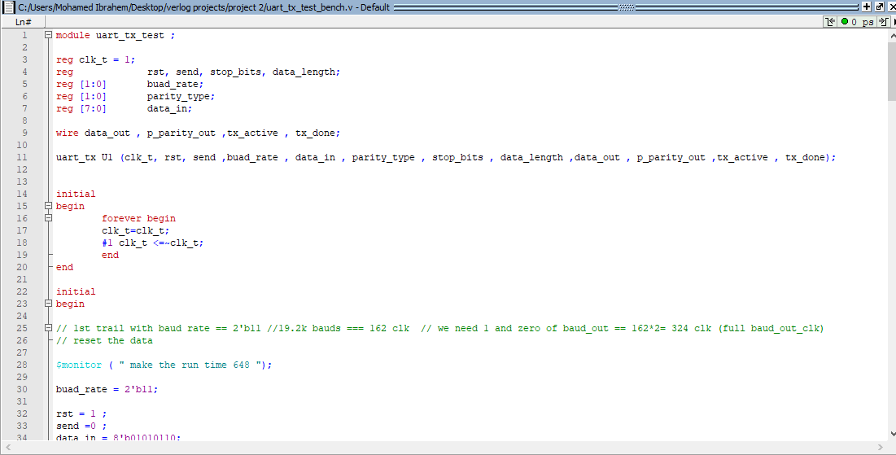
UART_TEST_BENCH

Slide 36
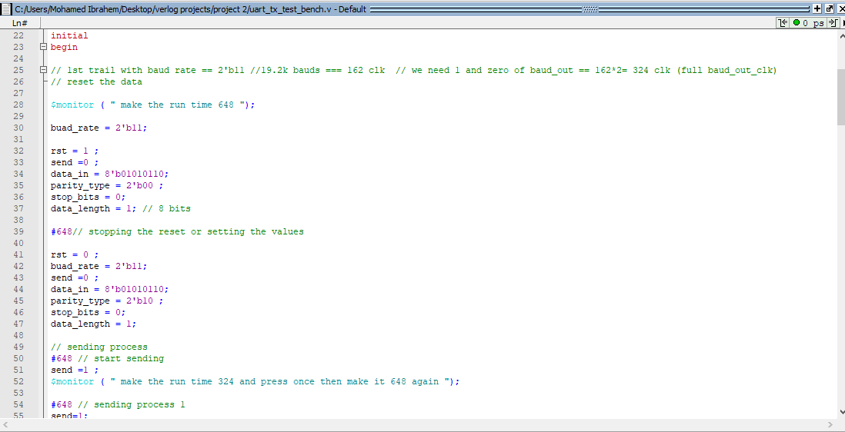

Slide 37
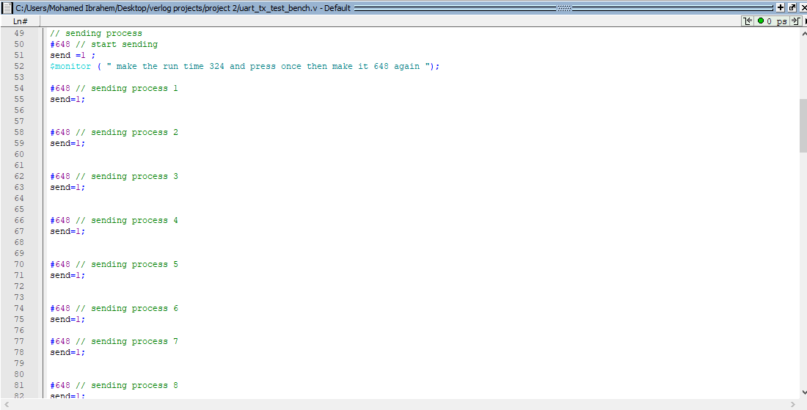

Slide 38
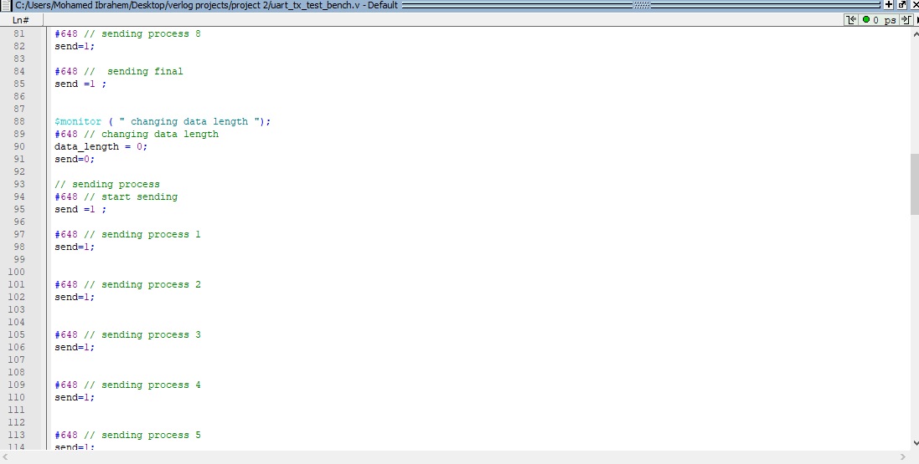

Slide 39
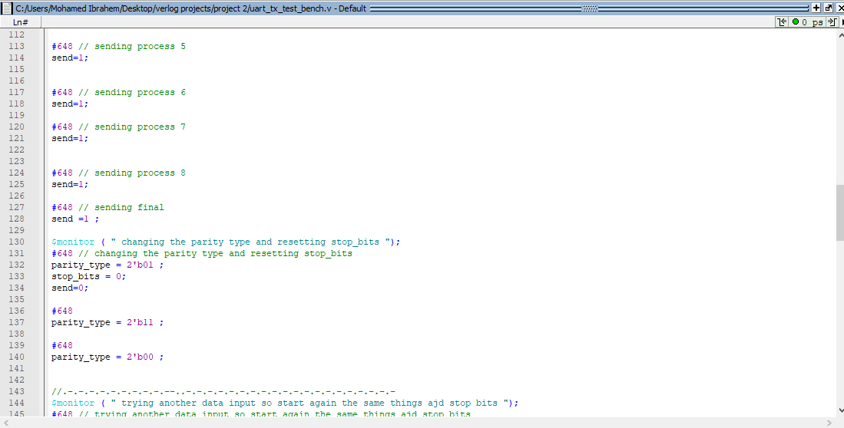

Slide 40
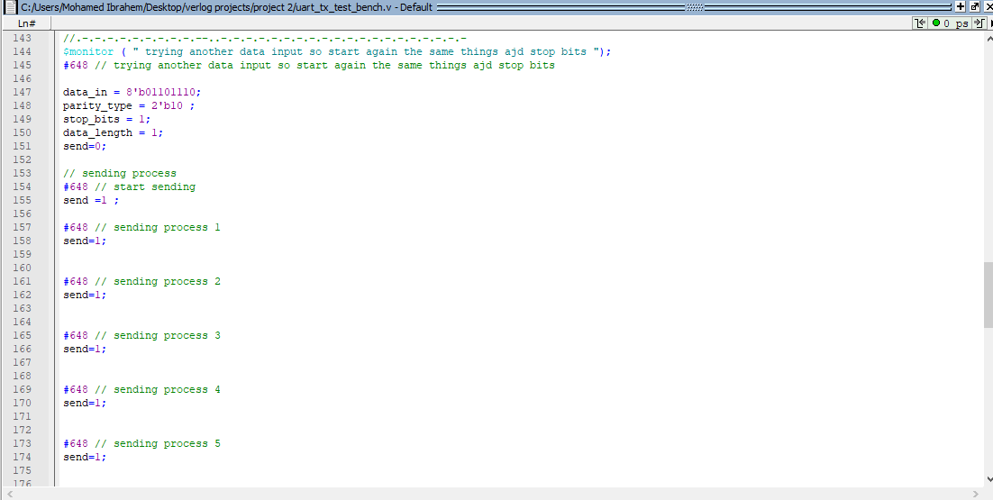

Slide 41
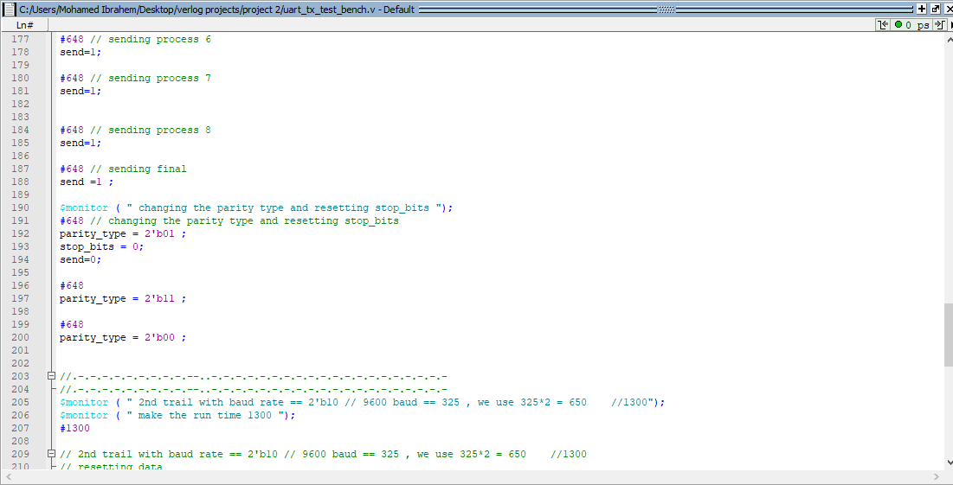

Slide 42
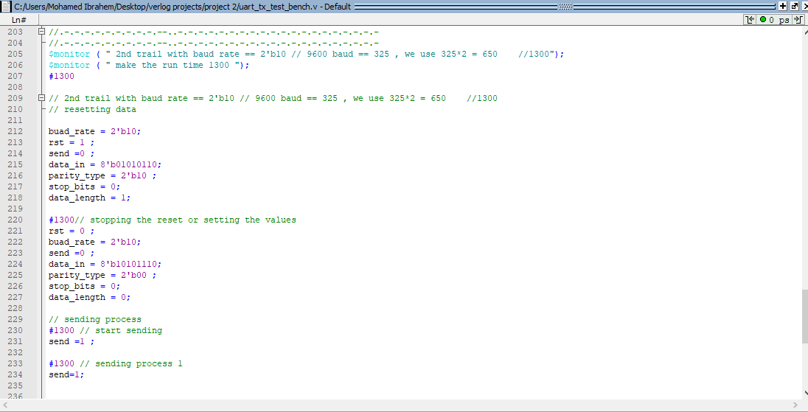

Slide 43
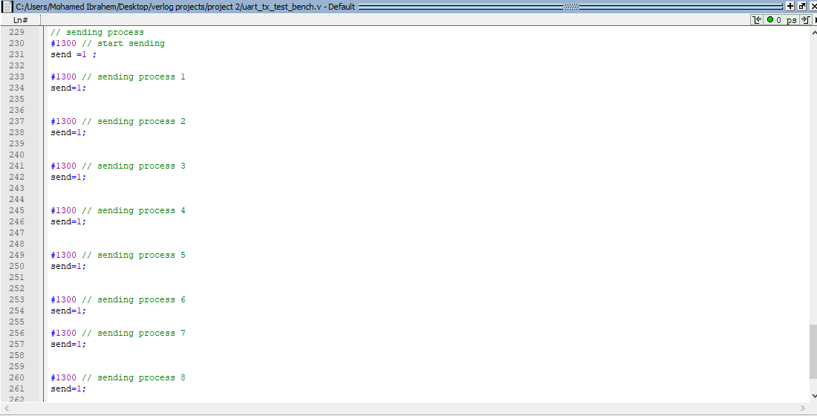

Slide 44
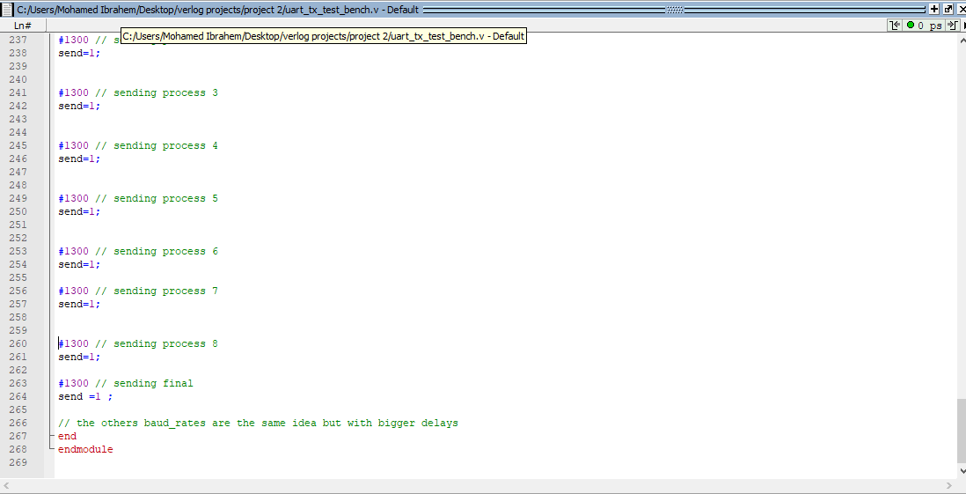

Slide 45
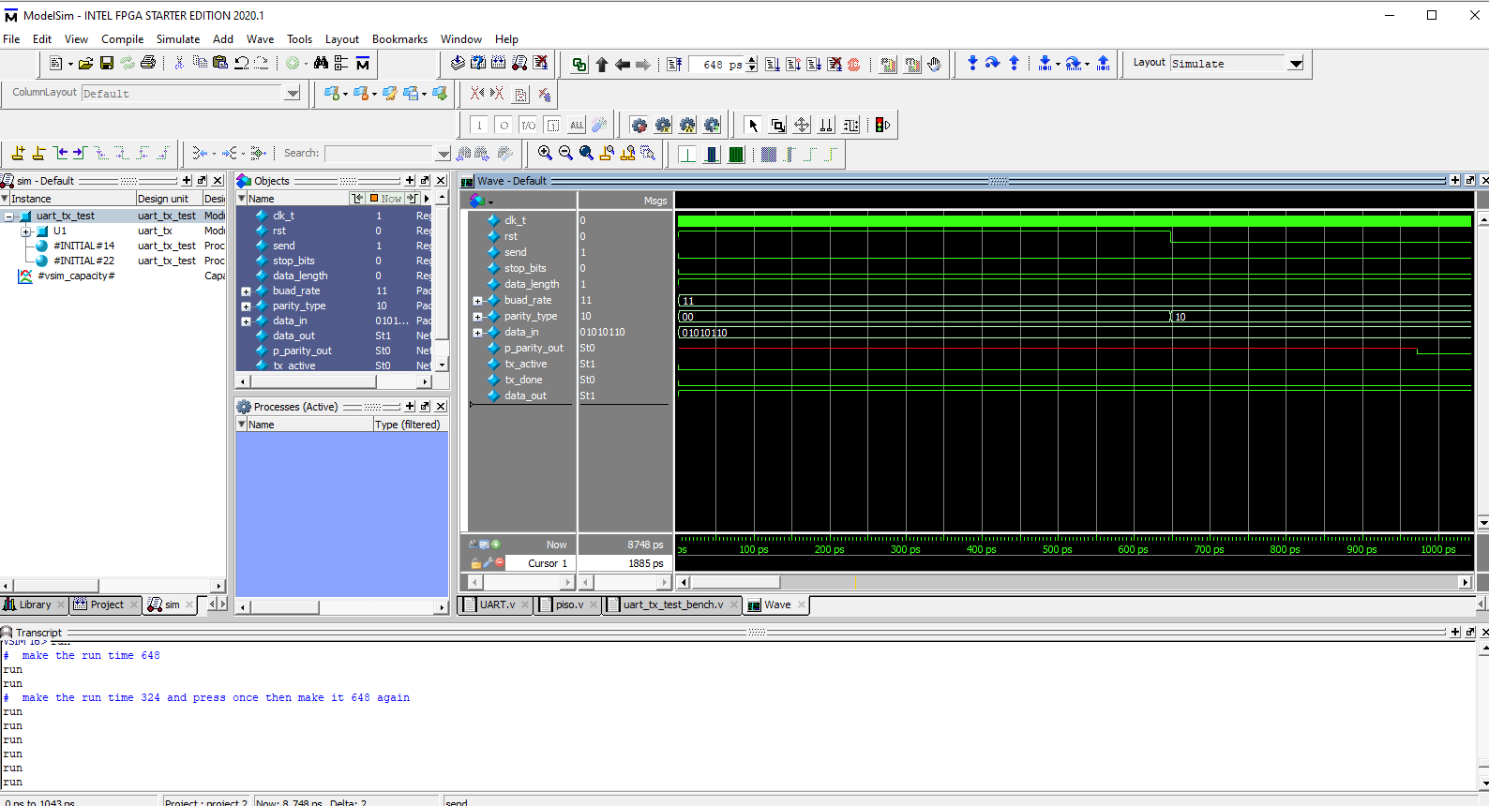
SIMULATION

Slide 46
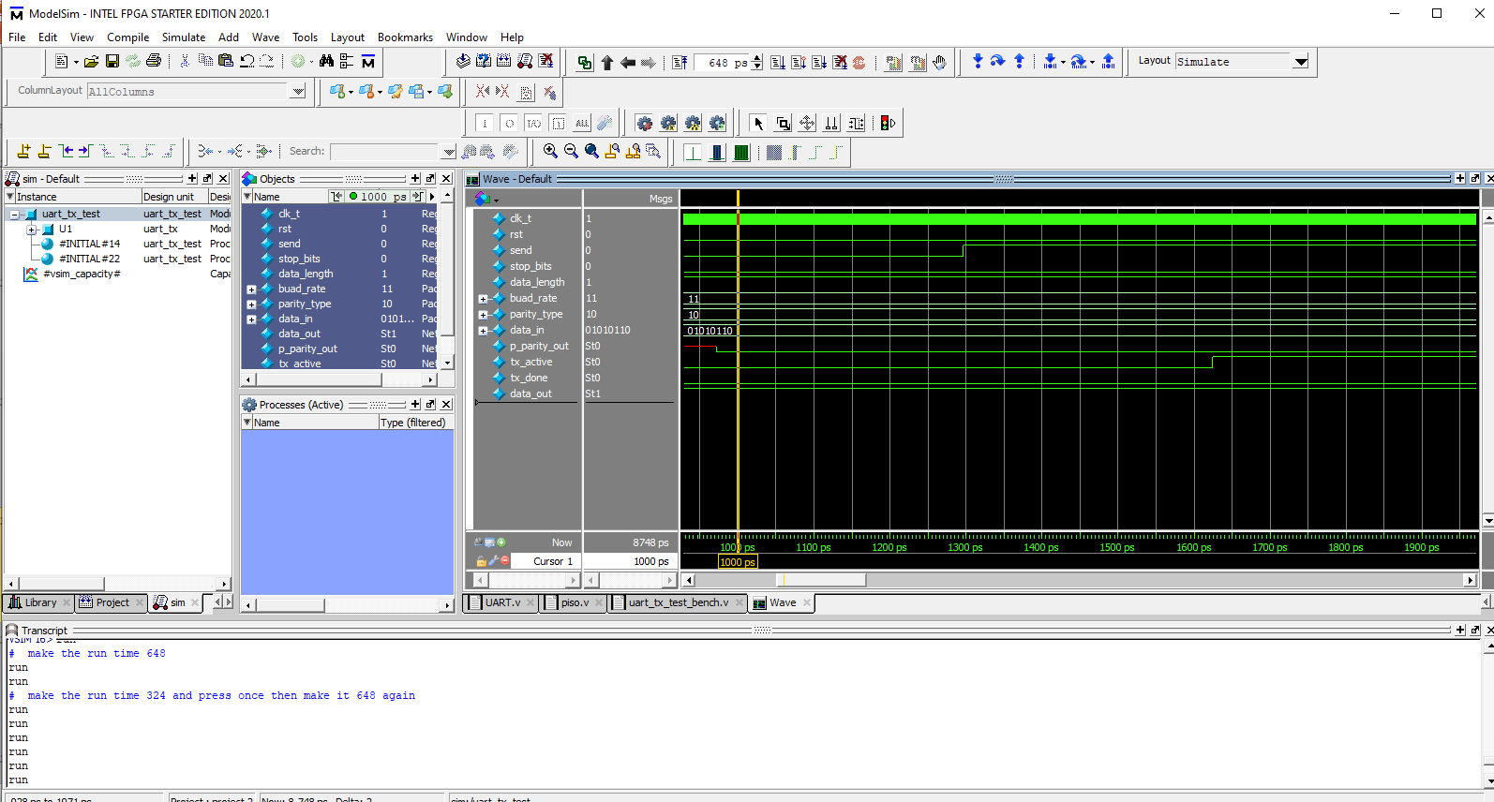

Slide 47
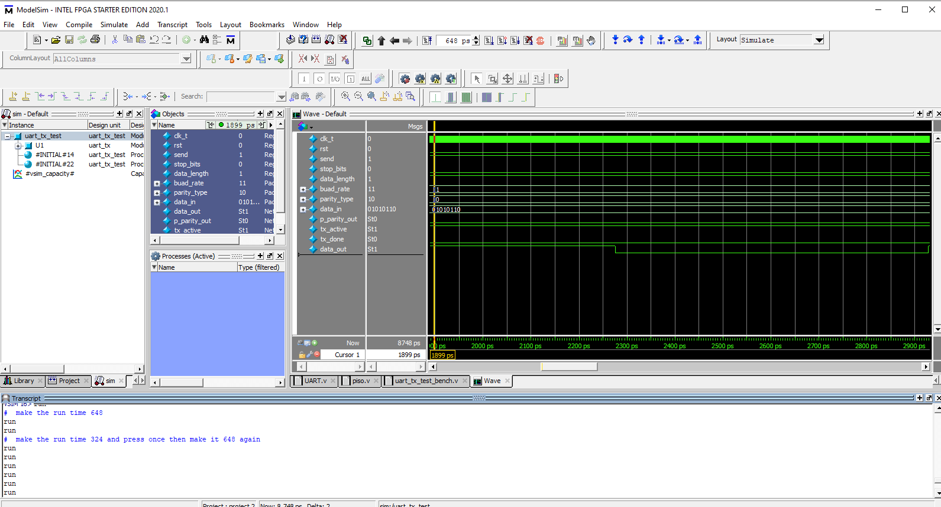

Slide 48
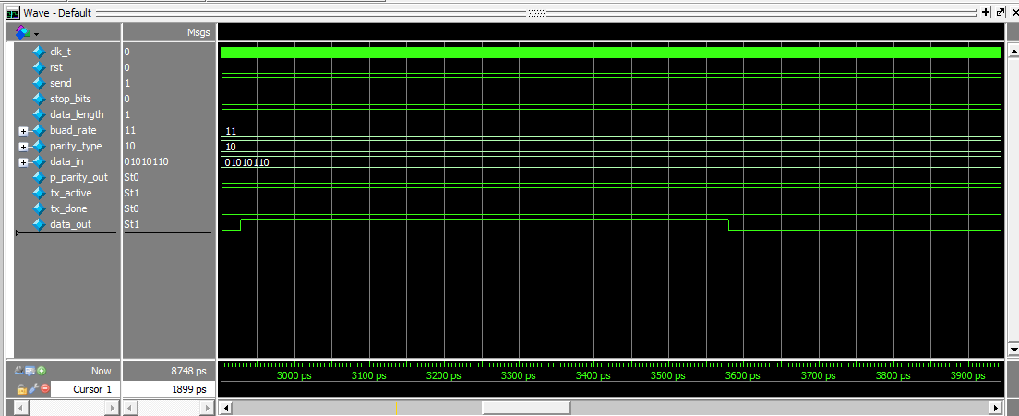

Slide 49
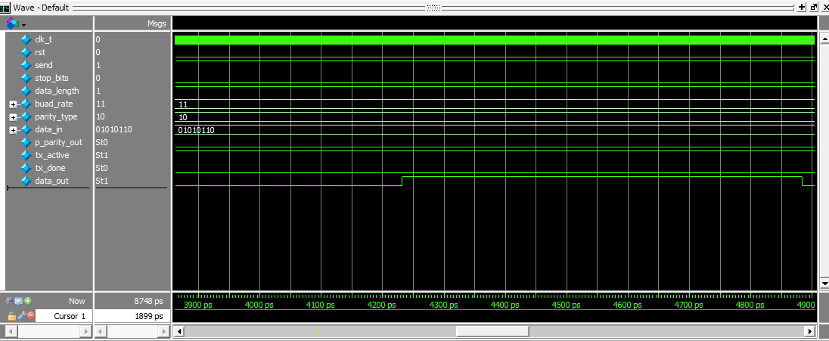

Slide 50
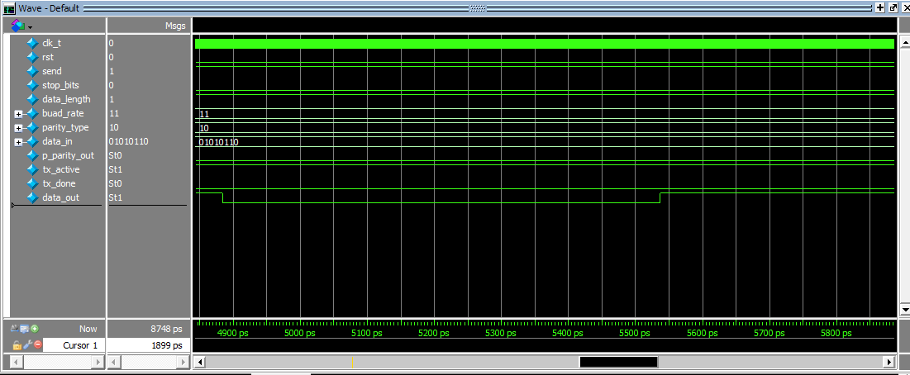

Slide 51
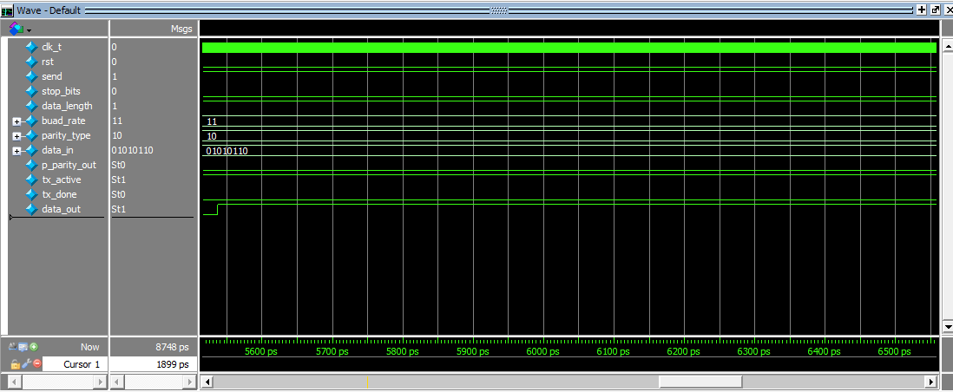

Slide 52
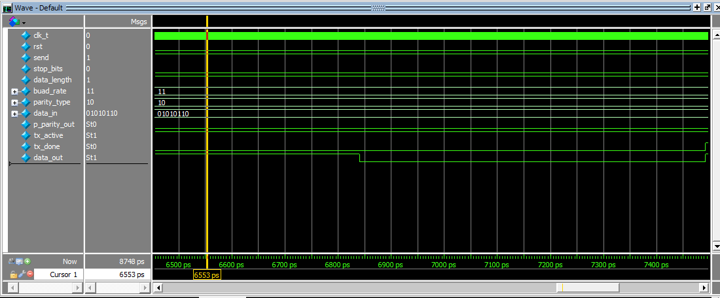

Slide 53
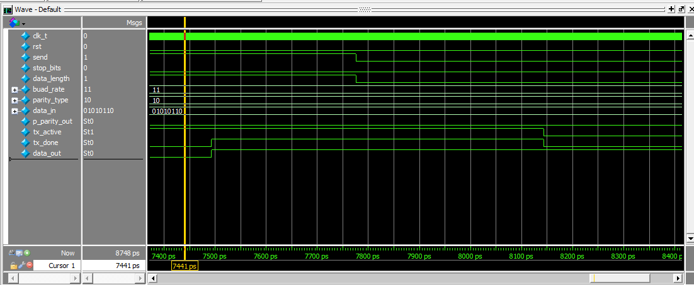

Slide 54
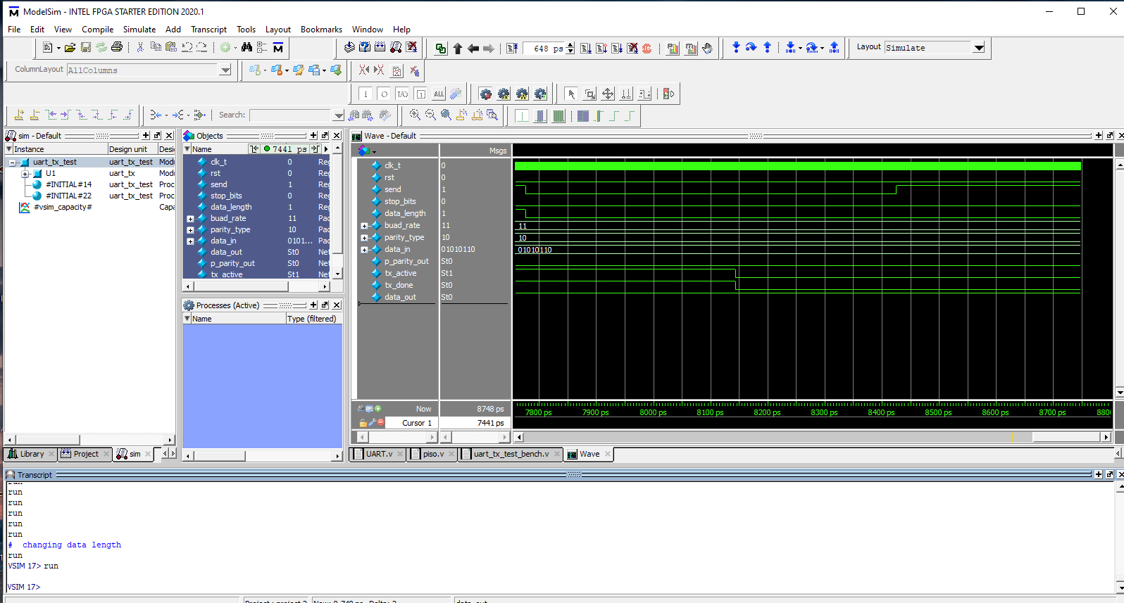

Slide 55
And so on….. The best way to understand the test_bench by reading it, we put notes all around the test_bench to make it easer to be read. The code in the next pages again…

Slide 56
module uart_tx_test ;
reg clk_t = 1;
reg rst, send, stop_bits, data_length;
reg [1:0] buad_rate;
reg [1:0] parity_type;
reg [7:0] data_in;
wire data_out , p_parity_out ,tx_active , tx_done;
uart_tx U1 (clk_t, rst, send ,buad_rate , data_in , parity_type , stop_bits , data_length ,data_out , p_parity_out ,tx_active , tx_done);
initial
begin
forever begin
clk_t=clk_t;
#1 clk_t <=~clk_t;
end
end

Slide 57
initial
begin
// 1st trail with baud rate == 2'b11 //19.2k bauds === 162 clk // we need 1 and zero of baud_out == 162*2= 324 clk (full baud_out_clk)
// reset the data
$monitor ( " make the run time 648 ");
buad_rate = 2'b11;
rst = 1 ;
send =0 ;
data_in = 8'b01010110;
parity_type = 2'b00 ;
stop_bits = 0;
data_length = 1; // 8 bits
#648// stopping the reset or setting the values
rst = 0 ;
buad_rate = 2'b11;

Slide 58
send =0 ;
data_in = 8'b01010110;
parity_type = 2'b10 ;
stop_bits = 0;
data_length = 1;
// sending process
#648 // start sending
send =1 ;
$monitor ( " make the run time 324 and press once then make it 648 again ");
#648 // sending process 1
send=1;
#648 // sending process 2
send=1;
#648 // sending process 3
send=1;

Slide 59
#648 // sending process 4
send=1;
#648 // sending process 5
send=1;
#648 // sending process 6
send=1;
#648 // sending process 7
send=1;
#648 // sending process 8
send=1;
#648 // sending final
send =1 ;
$monitor ( " changing data length ");
#648 // changing data length
data_length = 0;
send=0;

Slide 60
// sending process
#648 // start sending
send =1 ;
#648 // sending process 1
send=1;
#648 // sending process 2
send=1;
#648 // sending process 3
send=1;
#648 // sending process 4
send=1;
#648 // sending process 5
send=1;

Slide 61
#648 // sending process 6
send=1;
#648 // sending process 7
send=1;
#648 // sending process 8
send=1;
#648 // sending final
send =1 ;
$monitor ( " changing the parity type and resetting stop_bits ");
#648 // changing the parity type and resetting stop_bits
parity_type = 2'b01 ;
stop_bits = 0;
send=0;

Slide 62
#648
parity_type = 2'b11 ;
#648
parity_type = 2'b00 ;
//.-.-.-.-.-.-.-.-.-.--..-.-.-.-.-.-.-.-.-.-.-.-.-.-.-.-.-.-.-.-
$monitor ( " trying another data input so start again the same things ajd stop bits ");
#648 // trying another data input so start again the same things ajd stop bits
data_in = 8'b01101110;
parity_type = 2'b10 ;
stop_bits = 1;
data_length = 1;
send=0;
// sending process
#648 // start sending
send =1 ;
#648 // sending process 1
send=1;

Slide 63
#648 // sending process 2
send=1;
#648 // sending process 3
send=1;
#648 // sending process 4
send=1;
#648 // sending process 5
send=1;
#648 // sending process 6
send=1;
#648 // sending process 7
send=1;
#648 // sending process 8
send=1;

Slide 64
#648 // sending final
send =1 ;
$monitor ( " changing the parity type and resetting stop_bits ");
#648 // changing the parity type and resetting stop_bits
parity_type = 2'b01 ;
stop_bits = 0;
send=0;
#648
parity_type = 2'b11 ;
#648
parity_type = 2'b00 ;
//.-.-.-.-.-.-.-.-.-.--..-.-.-.-.-.-.-.-.-.-.-.-.-.-.-.-.-.-.-.-
//.-.-.-.-.-.-.-.-.-.--..-.-.-.-.-.-.-.-.-.-.-.-.-.-.-.-.-.-.-.-
$monitor ( " 2nd trail with baud rate == 2'b10 // 9600 baud == 325 , we use 325*2 = 650 //1300");
$monitor ( " make the run time 1300 ");
#1300

Slide 65
// 2nd trail with baud rate == 2'b10 // 9600 baud == 325 , we use 325*2 = 650 //1300
// resetting data
buad_rate = 2'b10;
rst = 1 ;
send =0 ;
data_in = 8'b01010110;
parity_type = 2'b10 ;
stop_bits = 0;
data_length = 1;
#1300// stopping the reset or setting the values
rst = 0 ;
buad_rate = 2'b10;
send =0 ;
data_in = 8'b10101110;
parity_type = 2'b00 ;
stop_bits = 0;
data_length = 0;
// sending process
#1300 // start sending
send =1 ;

Slide 66
#1300 // sending process 1
send=1;
#1300 // sending process 2
send=1;
#1300 // sending process 3
send=1;
#1300 // sending process 4
send=1;
#1300 // sending process 5
send=1;
#1300 // sending process 6
send=1;
#1300 // sending process 7
send=1;

Slide 67
#1300 // sending process 8
send=1;
#1300 // sending final
send =1 ;
// the others baud_rates are the same idea but with bigger delays
end
endmodule

